Slide 1

Predicting house prices
Final project
Eliyahu Elimelech & Segev Cohen

Slide 2





Project Overview
Dataset
Statistic measure
Target column
Sberbank (30471,391)
RMSLE
Price_Doc
Raw Data
EDA
Data cleaning
Feature engineering
Model
Evaluate
Hyper Parameter Tuning
Submission

Slide 3
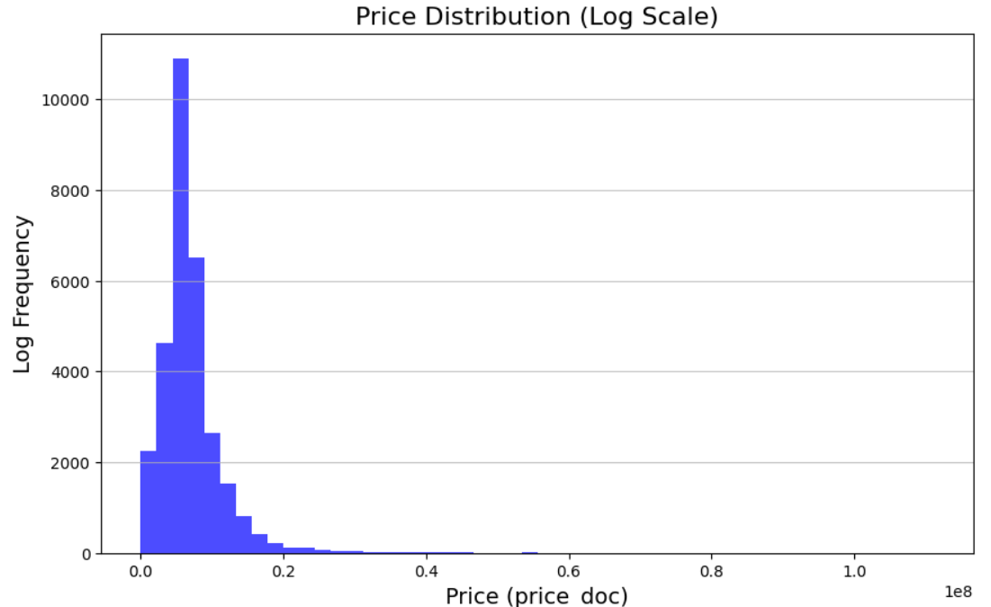
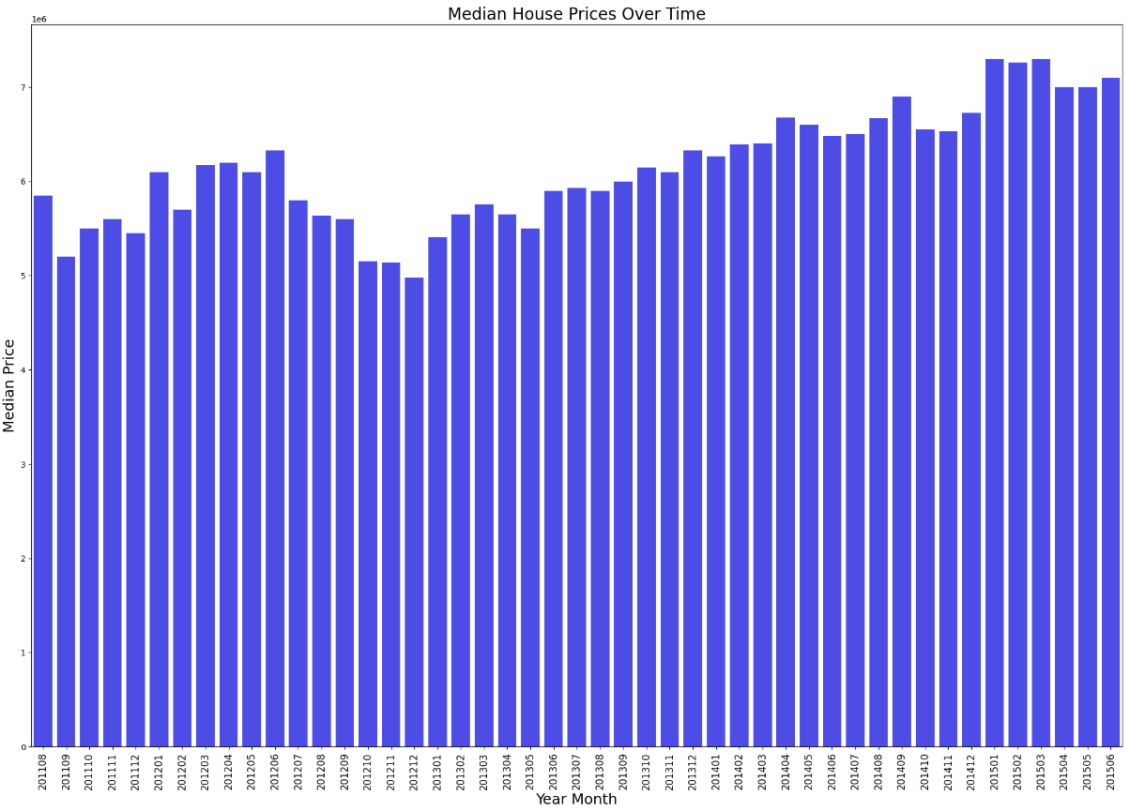
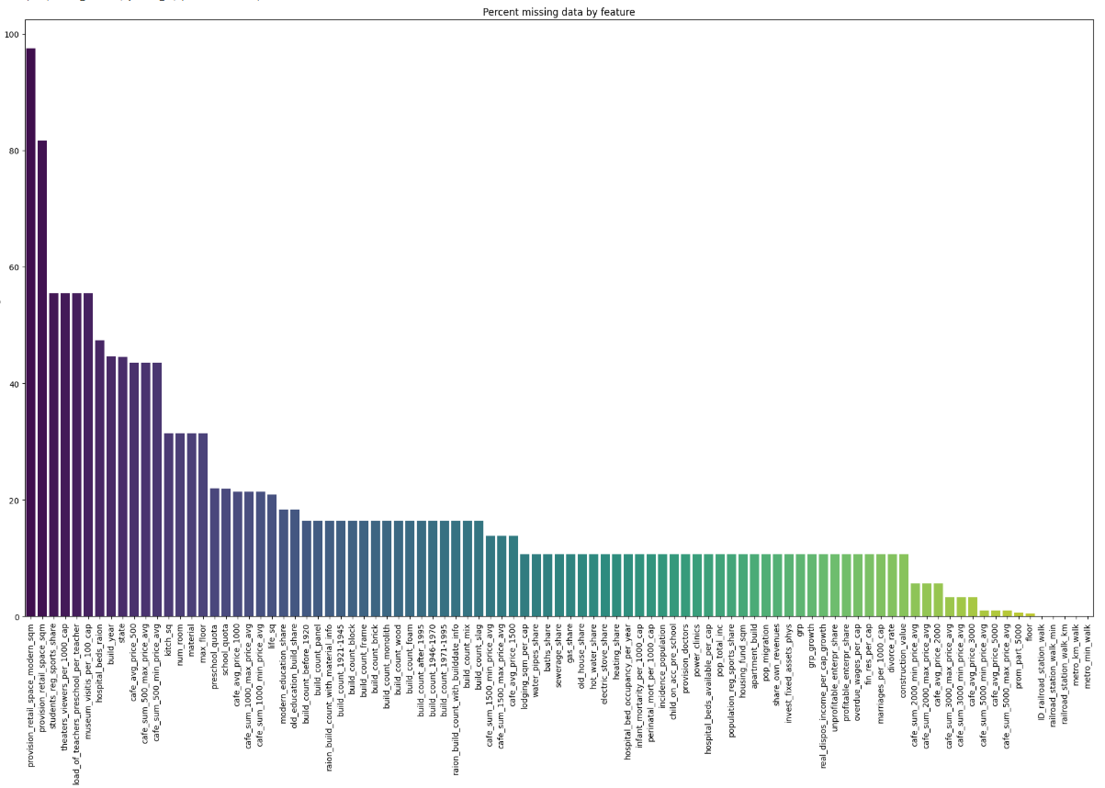
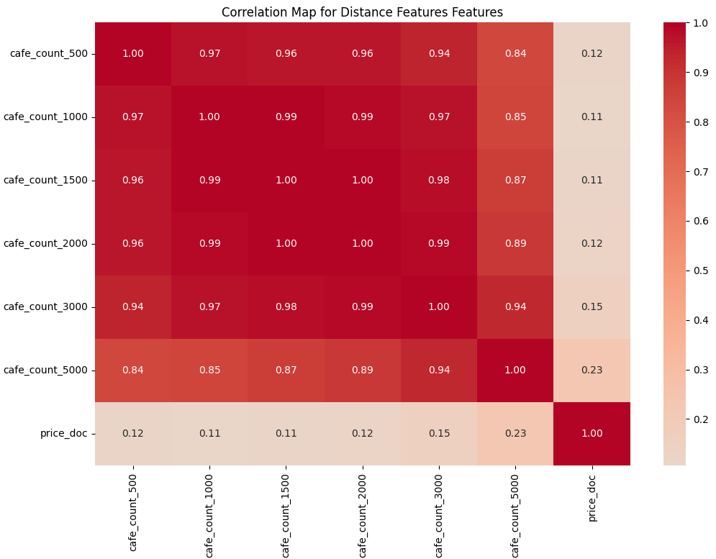
Raw Data & EDA
Price_Doc Distribution
Price_Doc Distribution by year
Missing Values
Correlation

Slide 4
Data cleaning
Data Corrections:
Logical checks ensured data consistency
full_sq > life_sq / build_year > 1500 / 10000 < price_per_sq < 600000
Handling missing values:
Missing values treatment diverge to some methods: remove column, fill with avg, fill with KNN
Outliers:
We removed the lower and upper 1900 outliers of the price_doc column

Slide 5
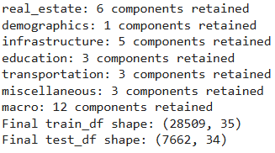
Feature engineering
Label encoding:
Transform categorial and binary features into numeric columns
New features create:
Avg_room_size (life_sq/num_room), Month, Day, Rel_kitchen_sq
PCA:
Reduce dimentionality
Improve model efficiency
Handle multicollinearity

Slide 6
Model
Model selection:
We tried using simplified models such as Linear Regression and Polynomial Regression, as well as feature selection methods like Lasso, Ridge, and Stepwise. Additionally, we utilized advanced models such as Random Forest and XGBoost.
Chosen Model: XGBOOST due to its lowest rmsle
Training process:
Used 5 fold cross validation

Slide 7
RMSLE Improvement Timeline
Base line
1
2
3
xGBOOST
Outliers
KNN
tuning
Data clening, Feature engineering
RMSLE:0.469
Data clening, Feature engineering, Outliers
RMSLE:0.334
Data clening, Feature engineering, Outliers, KNN
RMSLE:0.331
Data clening, Feature engineering, Outliers, KNN, Tuning
RMSLE:0.330

